Slide 1


Analysis
Finding

Slide 2


Today's agenda
Project recap
Problem
The Analytics team
Process
Insights
Summary

Slide 3

Social Buzz is a fast growing technology unicorn that need to adapt quickly to it’s global scale Accenture has begun a 3 month POC focusing on these task:
An audit of their big data practice
Recommendations for a successful IPO
An analysis of their content categories that highlights the top 5 categories with the largest aggregate popularity
Project Recap

Slide 4


Problem
1.) Top 5 categories with the largest aggregate popularity
2.) Popularity Share Percentage from Top Category
3.) Month with the Most Posts
4.) Number of Unique Categories

Slide 5



The Analytics team

Slide 6
Process
1
Data Understanding
2
Data Cleaning
3
Data Modelling
4
Data Analysis
5
Uncover Insights

Slide 7
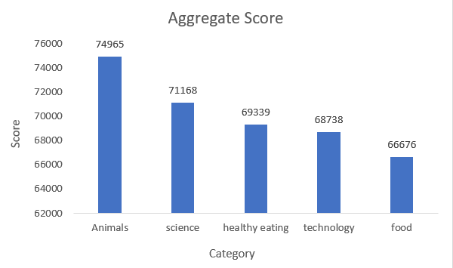

Insights
1.) Top 5 categories with the largest aggregate popularity

Slide 8
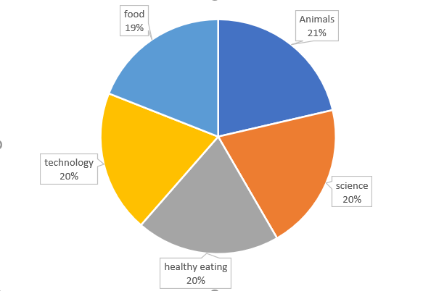
2.) Popularity Share Percentage from Top Category

Slide 9
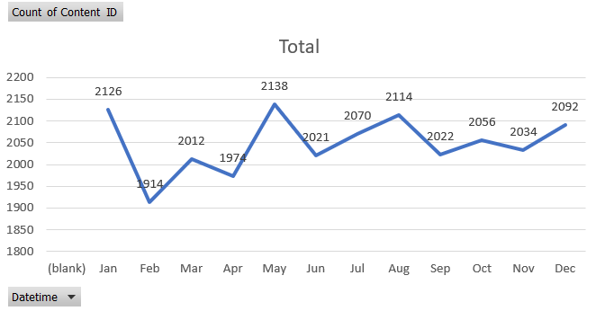
3.) Month with the Most Posts

Slide 10
4.) Number of Unique Categories
Animals
Science
Healthy Eating
Technology
Culture
Travel
Cooking
Soccer
Fitness
Studying
Dogs
Tennis
Food
Veganism
Education
Public Speaking

Slide 11

1.) Animal Category has the highest reaction followed by science, healthy eating, technology, food.
2.) Popularity Share Percentage from Top Category
3.) Month of May has the highest post.
4.) In total there are 16 Unique Category.
Summary

Slide 12

Thank you!
ANY QUESTIONS?

